Slide 1
Project- Health Indicator App
Scope: Create an app to analyse, predict diseases status & generate a customised online report with health indicator
Dataset: heart_disease.csv
Source: Kaggle https://www.kaggle.com/code/ahmedklabi/heart-disease-pred/data
Team Members:
Daniela Cornea (DC)
Anh Huong (AH)
Kevin Nguyen (KN)
Project repo: https://github.com/DCornea5/Final-Project.git

Slide 2
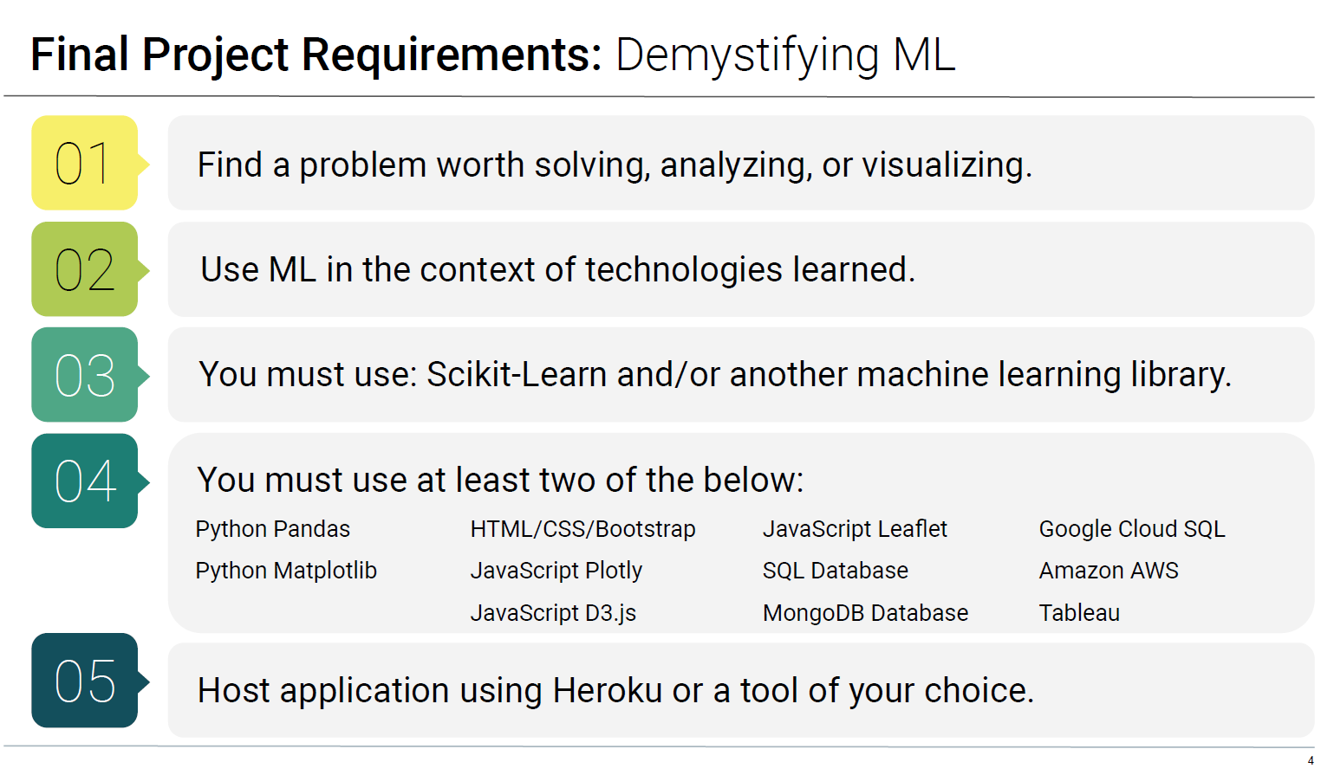
Project High Level Requirements

Slide 3
Project Plan
Research project topic & select dataset
Create project plan
Create project repo
App development: Break down key components and assign the lead for each component:
Data preparation and machine learning models: KN
Data visualisations: DC
Web site creation: AH
Test & Deployment:
Unit test – perform during application development stage
System test (with db connection) – on local machine with all built components
End-to-end test/ dress rehearsal – on cloud platform
On-going task allocations: self-manage, support other team members as required
Documentations:
Project docs, reports
Presentation pack

Slide 4
Project Status Report
Task # | Descriptions | Assignee | Due Date | Status
 | Select project topic & dataset Agree key deliverables, dependencies and next activity due date Additional dataset can be obtained as required | All | 12/4/2022 | Completed
1 | Data Preparation: Technique/library: Python, PySpark, Pandas, Sklearn, tensorflow, etc… Analyse & clean dataset: determine the relevancy of the data fields by applying various algorithms & techniques Prepare data for visualisations | KN | 15/4/2022 | Not Started
2 | Machine Learning: Technique/library: Python, PySpark, Pandas, Sklearn, tensorflow, etc… Build ML model: create, train, test, save and re-load the model with new data by applying Scikit-Learn and/or another ML library | KN | TBC
3 | Data Visualisations: Technique/library: Python, Matplotly, dimple.js, D3, etc… Produce various visuals based on the cleaned dataset that completed by KN | DC | TBC
4 | Web design: Technique/library: Python flask, HTML, CSS, Javascript, etc… Create high level design of the app Create app website | AH | TBC
5 | Build database & host on cloud: Posgressql, sqllite, etc… | TBD | TBD
6 | Cloud platform deployment: Heroku, Azure, etc… | TBD | TBD

Slide 5
Project Dependencies, Issues & Constraints
Item# | Descriptions | Assignee | Due Date | Status
1 | Task 2, 3, & 4 has dependency on task 1 “Data preparation” | KN | 12/4/2022 | Open
2
3
4
5

